Slide 1

Mass Shootings Investigation
MSU Data Analytics Boot Camp
Project 1

Slide 2




Meet the team
Leah Apking
Treasure (data) Seeker
Julie Eremeeva
Cleanup Wizard
Nancy Gomez
API Whisper
Isidore Lozano
Analysis Jedi

Slide 4
Resources used
Mass Shootings
Census Data
Crime Data
The Violence Project Database
API Request to Census API
Gun Violence
Archive
Gun Policy
Everytown Research & Policy
Giffords Law Center: To Prevent Gun Violence

Slide 5
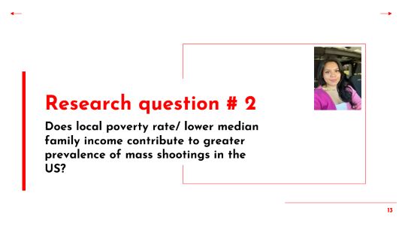
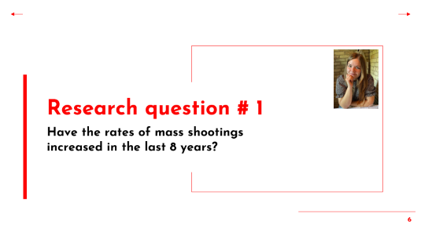
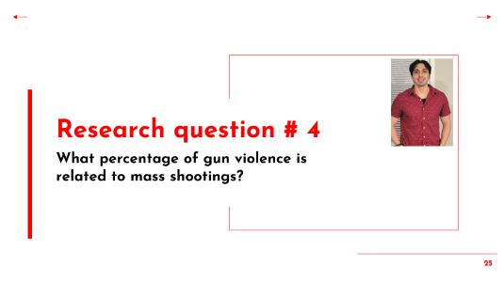
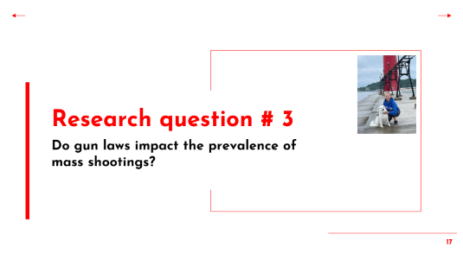

Slide 6
Research question # 1
Have the rates of mass shootings increased in the last 8 years?

Slide 7
Importing, cleaning, and summarizing Data.
Demo

Slide 8
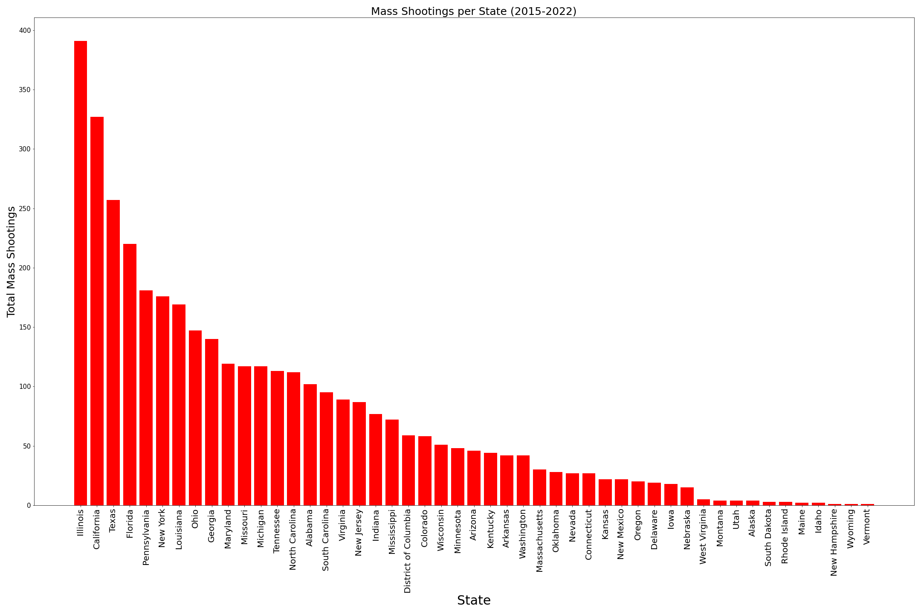
Illinois and California have the most incidents registered while Wyoming, Vermont, and New Hampshire had only 1 mass shooting occurred (2015-2022).

Slide 9
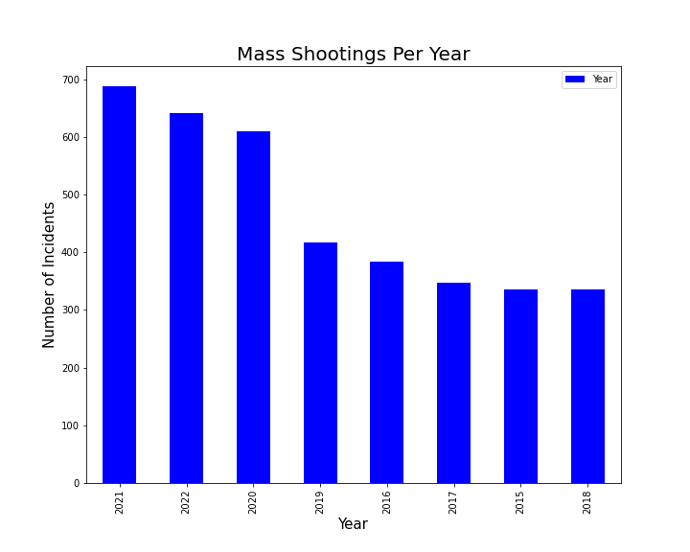
Mass Shootings Rates have been consistently increasing for the last 8 years. There was also a big increase in 2020 which could be related to the pandemic.

Slide 10
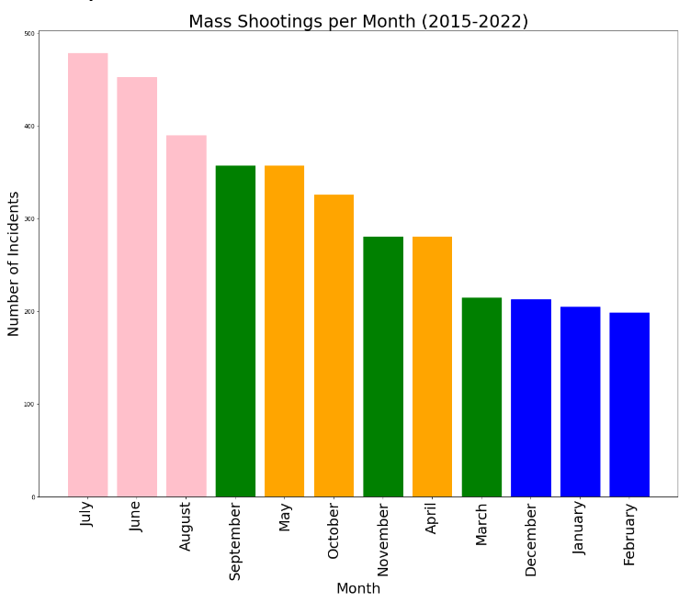
Based on the analyzed data, mass shootings occur more often in the summer months and less often in the winter months.

Slide 11
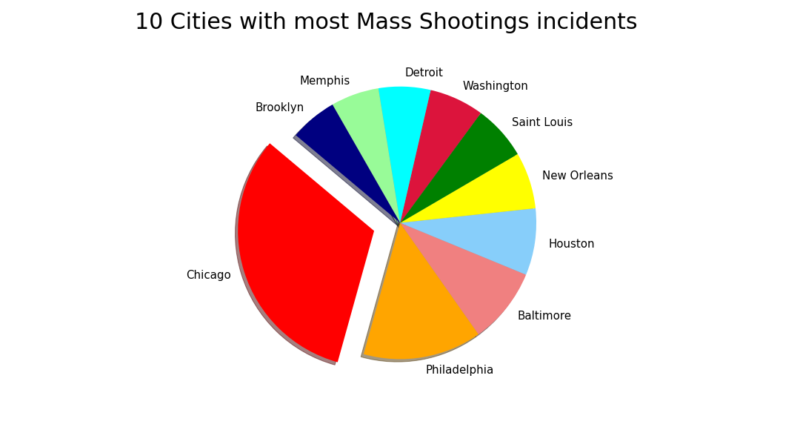
Chicago and Philadelphia have the largest number of incidents for the last 8 years.

Slide 12
Conclusions
Mass Shootings Rates have been consistently increasing.
Among all states, Illinois and California have the most incidents registered. The city that had the most incidents is Chicago, located in Illinois.
Based on the analyzed data, mass shootings occur more often in the summer months and less often in the winter months.
Chicago and Philadelphia have the largest number of incidents for the last 8 years.

Slide 13
Research question # 2
Does local poverty rate/ lower median family income contribute to greater prevalence of mass shootings in the US?

Slide 14
Working with Census API and visualizing Data.
Demo

Slide 15
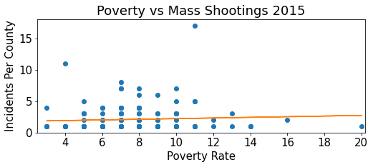
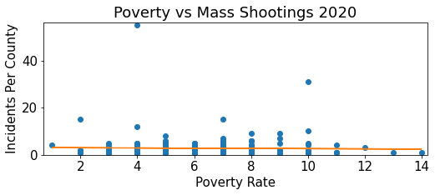

Slide 16
Conclusions
In 2015 as the poverty level increased the mass shooting also slightly increased.
There is a weak positive correlation between poverty rate and mass shootings in 2015
(r = 0.064).
In 2020 as the poverty level increased the mass shooting also slightly decreased.
There is a weak negative correlation between poverty rate and mass shootings in 2020
(r = -0.022).
Since the correlation between both years is weak, we can conclude that poverty rate/ lower median family income contributes very little to the greater prevalence of mass shootings in the us. Other factors that may further contribute to greater prevalence of mass shootings are mental health or access to firearms.

Slide 17
Research question # 3
Do gun laws impact the prevalence of mass shootings?

Slide 18
Analyzing Data on gun laws vs. mass shootings rates across the US.
Demo

Slide 19
Measuring State Gun Law Strength
Everytown Research & Policy analyzes the gun policies of all fifty states, awarding points for each policy.
Each law has a point value, those with more significant impact are worth more points.
Laws with the most significant impact include:
Background check requirement
Extreme risk laws
Elimination of the “Stand Your Ground” law
States are then ranked by the total points awarded out of 100.
#1. California (86.5 points)
#24. Michigan (25.5 points)
#50. Mississippi (3 points)

Slide 20
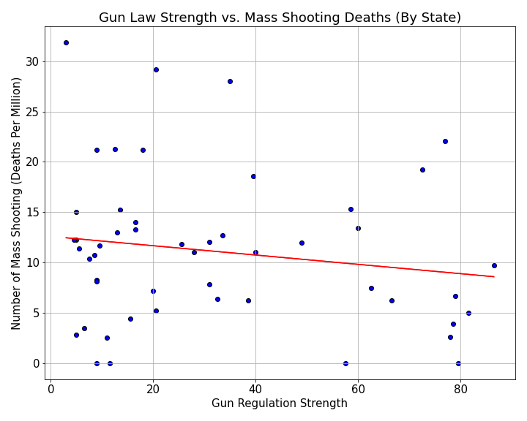
Do stricter gun laws result in fewer mass shooting deaths?
Everytown gun law strength scores; higher scores reflect stricter gun regulations.
Frequency of mass shooting deaths used to prevent skew of varying state populations.
Linear regression shows an overall decrease in frequency of mass shooting deaths as gun law strength increases.

Slide 21
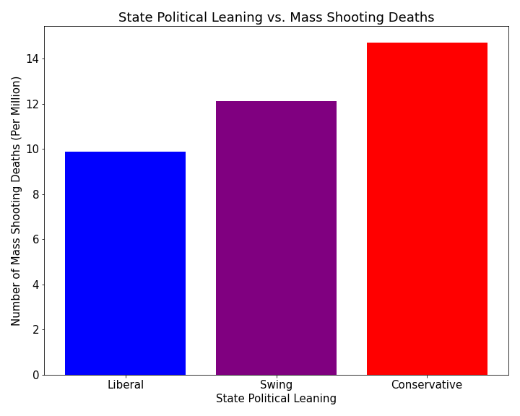
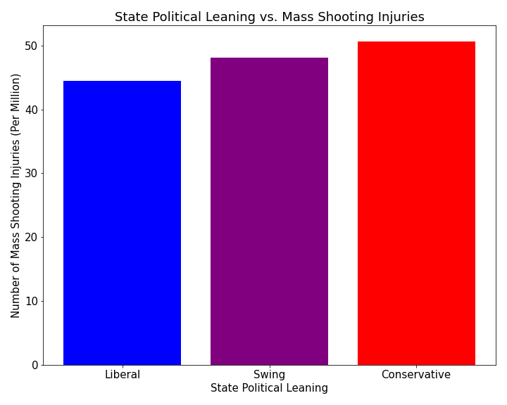
Does political leaning impact mass shooting deaths or injuries?
Some variation in mass shooting related death and injury frequency between traditionally red and blue states.

Slide 22
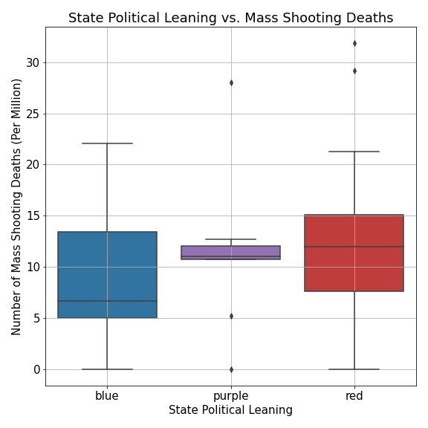
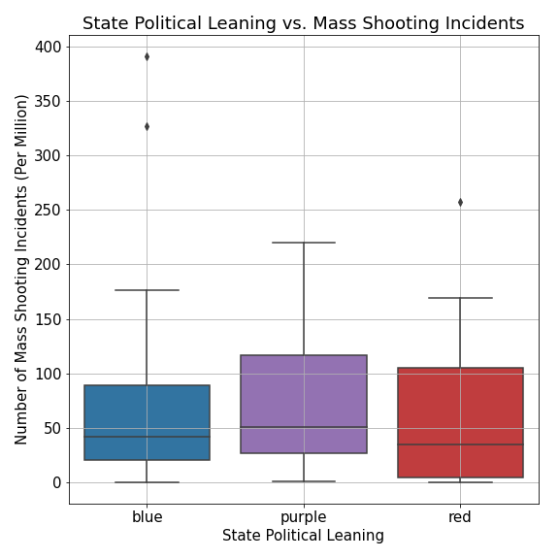
A Closer Look at Political Leaning
A set of ANOVA tests showed the variation between groups was not statistically significant. (p_{deaths}= 0.385; p_{incidents}= 0.641).

Slide 23
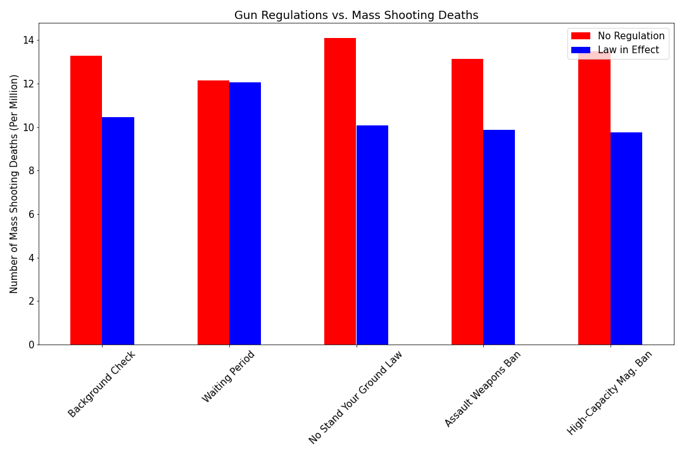
How do individual gun policies effect mass shooting deaths?
States with the restrictive gun policy had less frequent mass shooting deaths than those without the restriction in 5 of 5 cases.
Independent t-tests determined that the only policy showing a statistical difference was legislation removing “Stand Your Ground” or “Shoot First” laws (p = 0.047).

Slide 24
Conclusions
While restrictive gun legislation is one of the few current defenses against mass shooting incidents and the deaths and injuries they cause, the analysis conducted shows their effect is limited.
When controlling for size of population, states with more strict gun regulations experience fewer mass shooting incidents and deaths.
Overall, liberal (“blue”) states have less frequent mass shooting incidents and deaths than conservative (”red”) states.
Blue states also tend to have more strict gun laws.
The one case that showed a statistical significance, ending “Stand Your Ground” laws may help disprove the idea that arming more citizens will help protect the public in the event of a mass shooting.
It is also possible that more restrictive laws impact other kinds of gun violence outside of mass shootings.

Slide 25
Research question # 4
What percentage of gun violence is related to mass shootings?

Slide 26
Analyzing mass shootings data as part of the larger category (gun violence).
Demo

Slide 27
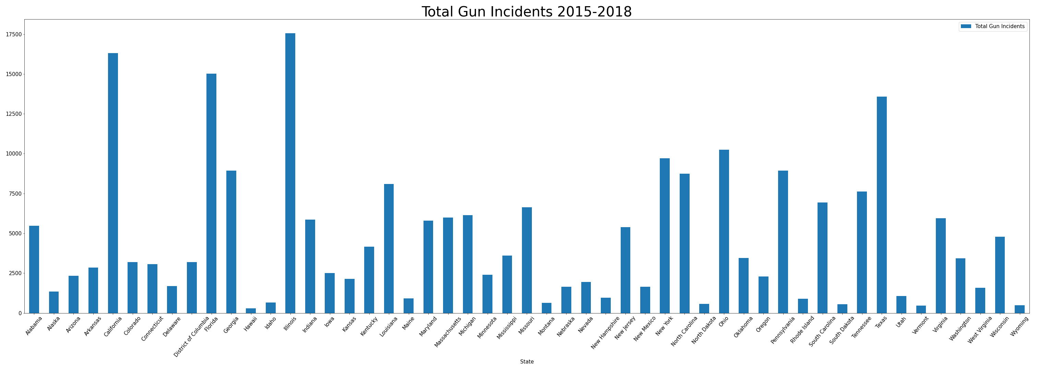

Slide 28
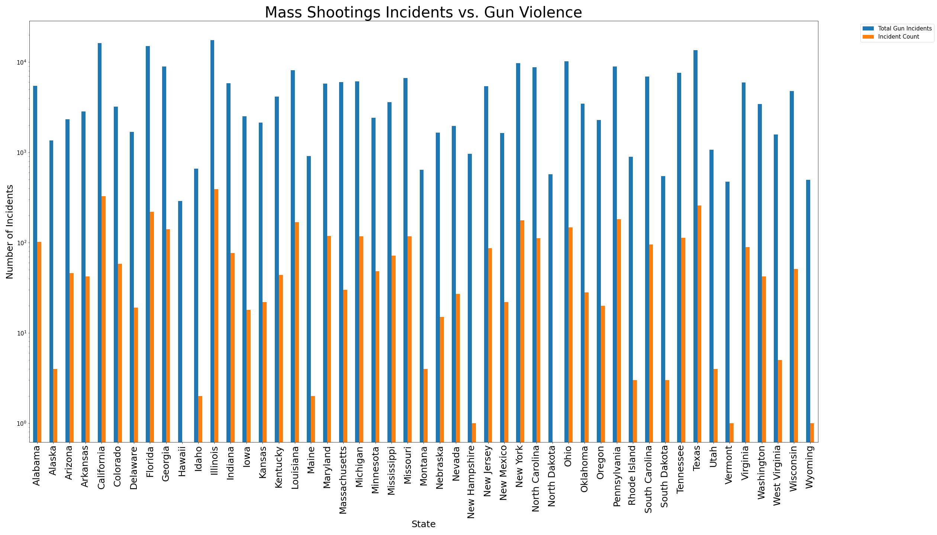

Slide 29
Conclusions
Although Mass shootings are the most talked about and broadcasted, they are just a tiny percentage of the total gun violence in states. The highest percentage one was 2% in Illinois.
States with higher gun violence did have more mass shootings than states with less gun violence.
It is possible that more action taken on gun violence in general will help lower the amount of mass shootings.

Slide 30
Key findings
Mass shootings have become more common over the last eight years.
More mass shootings take place in the summer than any other time of year.
There is no strong correlation between poverty rate and mass shootings incidents.
When controlling for size of population, states with more strict gun regulations experience fewer mass shooting incidents and deaths.
Overall, liberal (“blue”) states have less frequent mass shooting incidents and deaths than conservative (”red”) states.
Blue states also tend to have more strict gun laws.
In 5 out of 5 cases, the states with the more restrictive gun law also had fewer mass shooting related deaths.
Mass shootings constitute a small percentage of the total gun violence in the US.

Slide 31

Limitations
Only 8 years.
Crime reports can be not accurate.
Only the US (not worldwide trends).
Census data is not for every year.
Summary of gun laws (strict vs. not strict) instead of looking at the regulations for each state.
Not looking into details of each mass shooting
Location: schools, grocery stores, businesses, etc.
Shooter demographics, age, motive
Demographics of those targeted

Slide 32

Thank you for your attention!
Do you have any questions?

